Slide 1


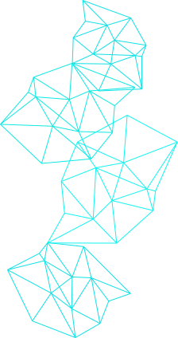
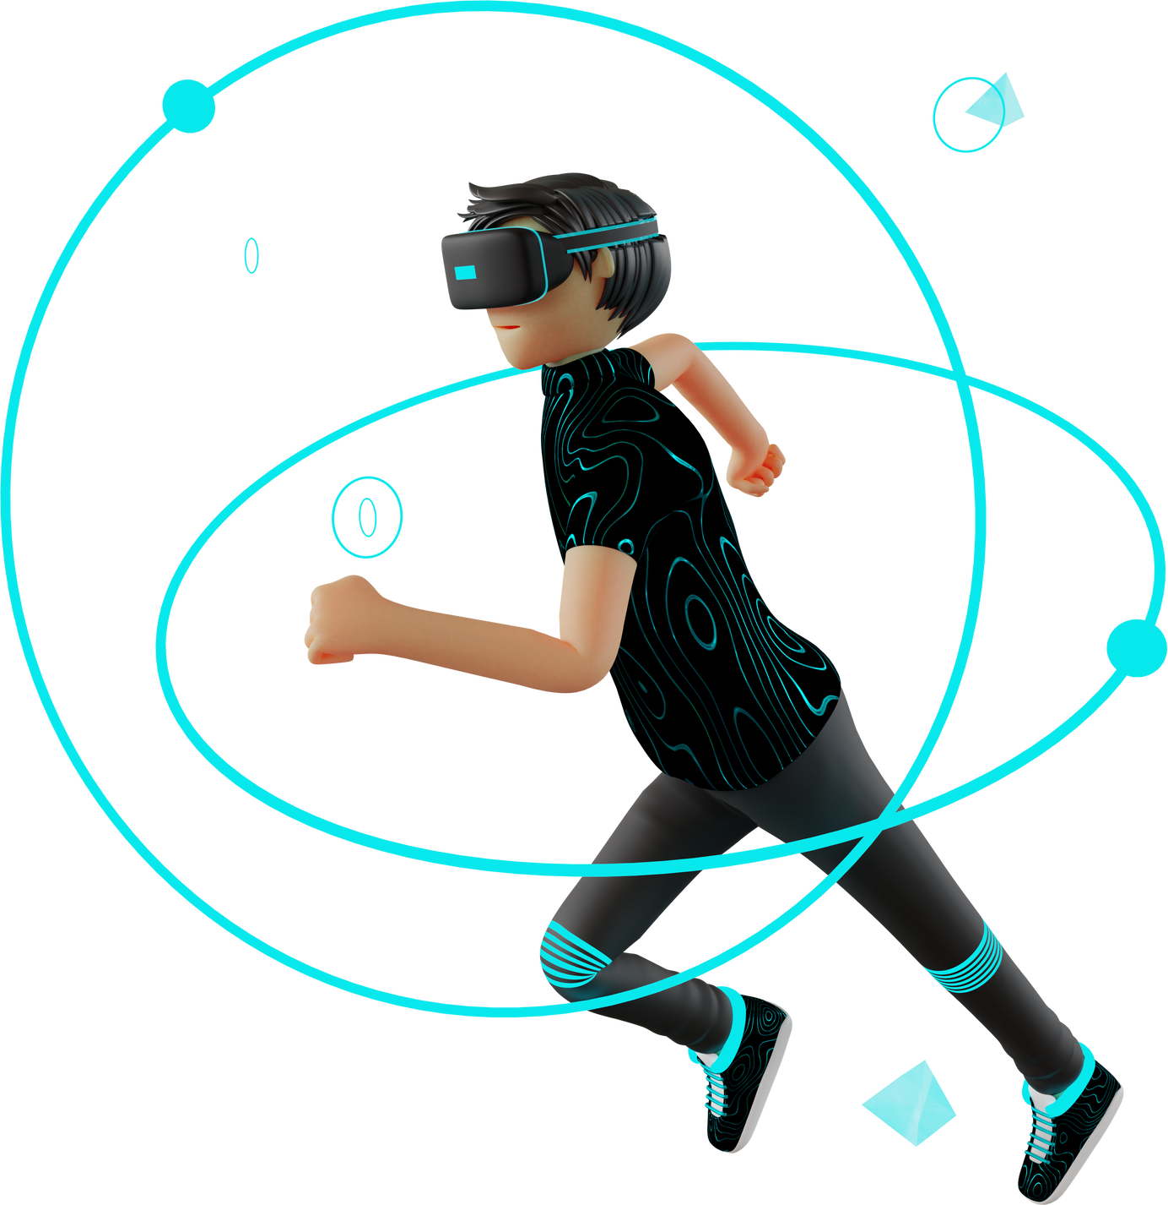

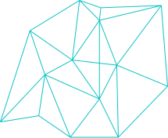
WELCOME TO
METACIRCUIT INNOVATIONS

Slide 2
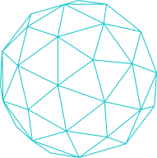
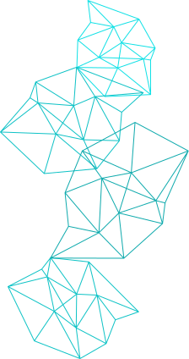
TABLE OF CONTENT
01
02
03
Introduction to Metaverse
Introduction to MetaCircuit Innovation
Objective of MetaCircuit Innovation
04
05
06
Procedure
followed for MetaCircuit Innovation
Future Scope
of MetaCircuit Innovation
Progress Details
of MetaCircuit Innovation

Slide 3

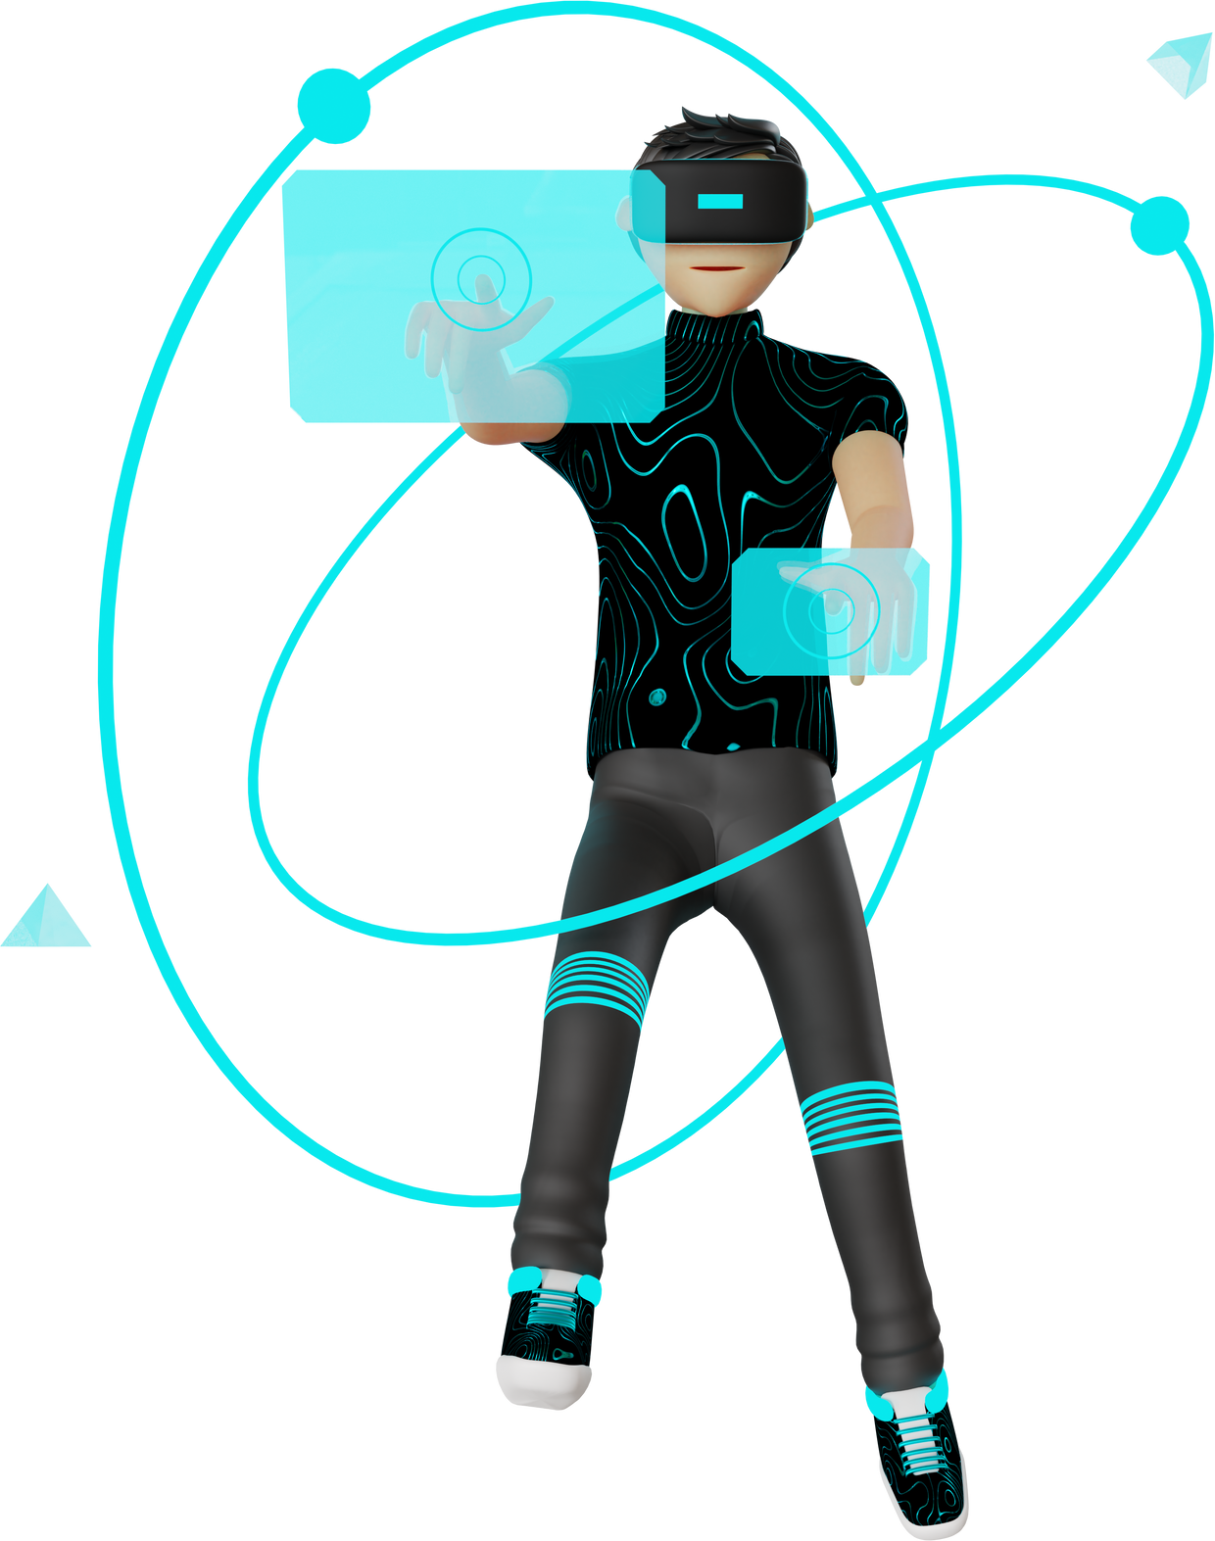
WHAT IS
METAVERSE ?
The metaverse is a vision of what many in the computer industry believe is the next iteration of the internet: a single, shared, immersive, persistent, 3D virtual space where humans experience life in ways they could not in the physical world

Slide 4
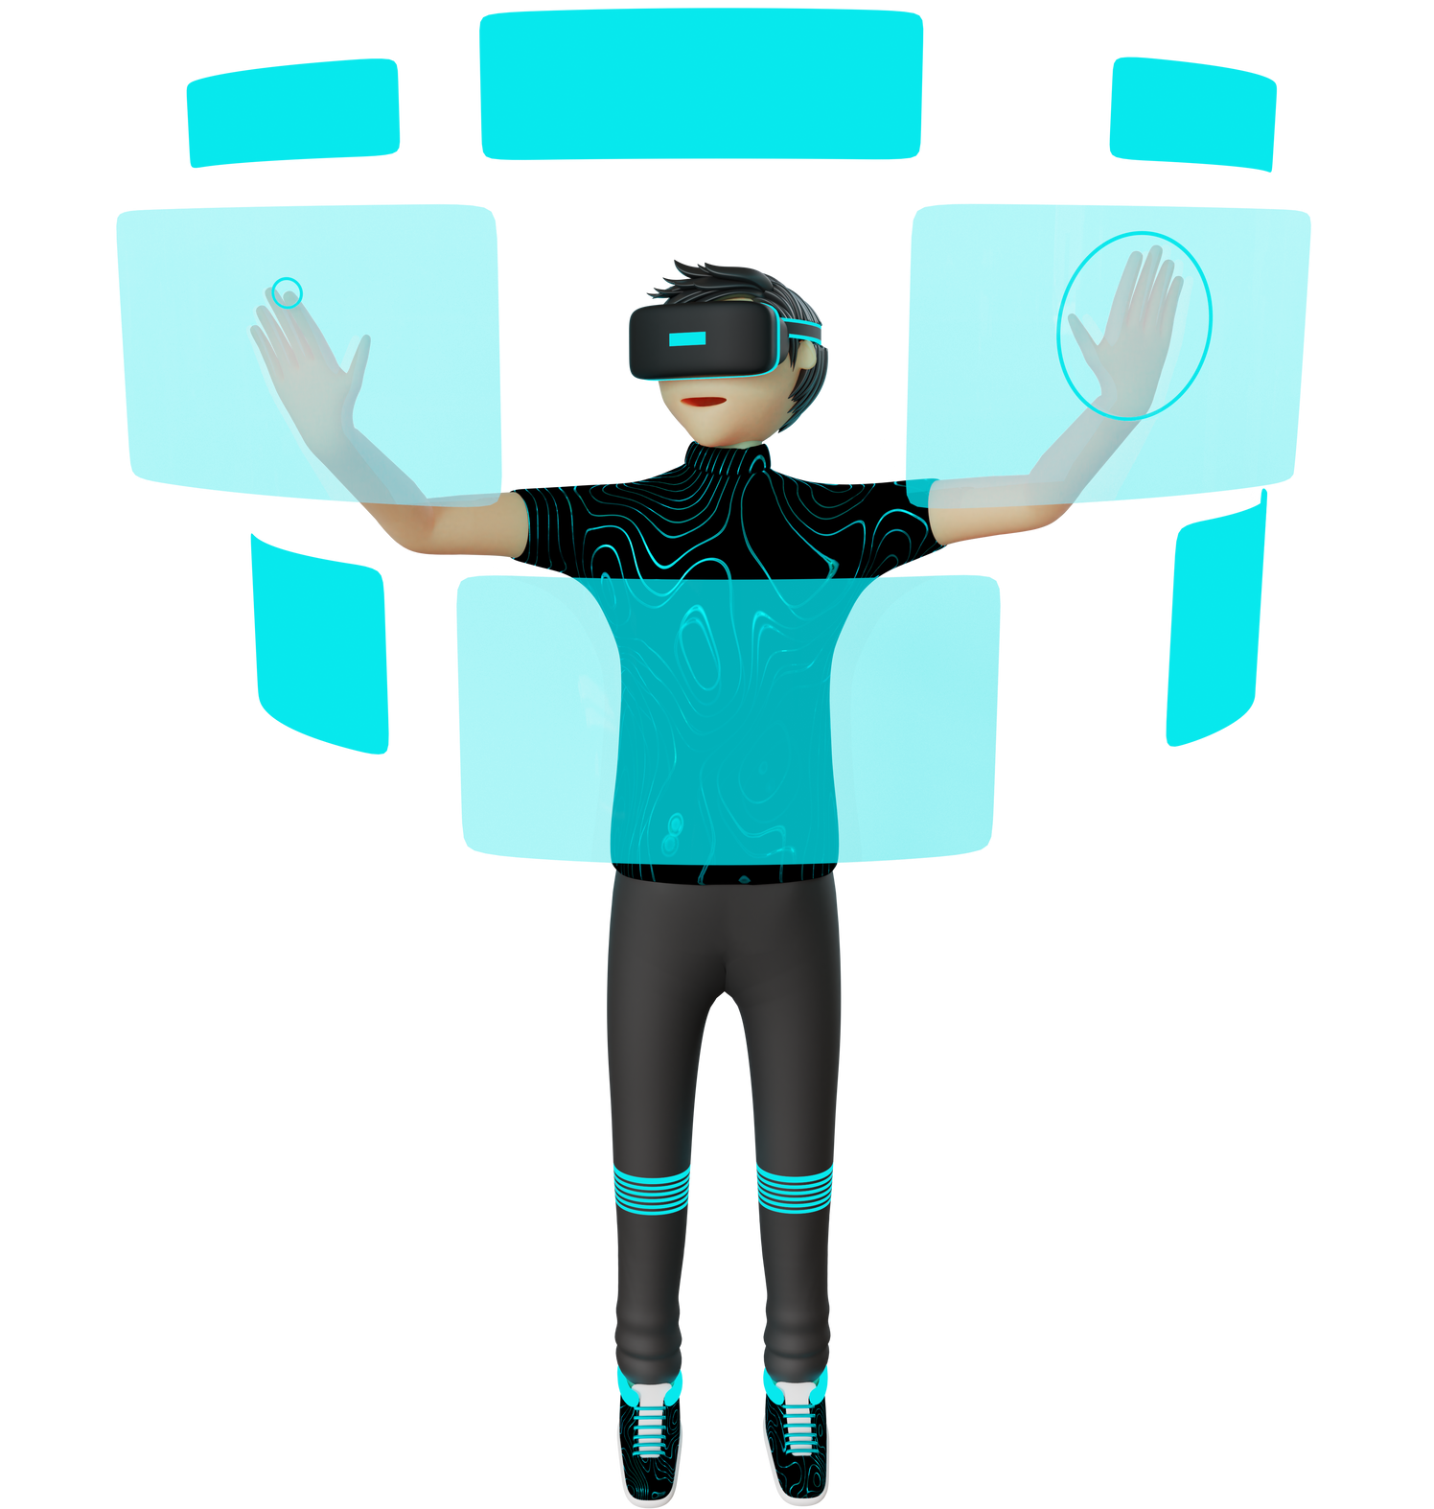
METACIRCUIT INNOVATION
A digital circuit lab in the metaverse is a virtual learning environment that allows students and enthusiasts to explore and experiment with digital electronic circuits in a simulated 3D space. It leverages virtual reality (VR) technology

Slide 5





REQUIRED TECHNOLOGY
METAVERSE DEVELOPMENT KIT
VR HEADSETS
3 D MODEL DEVELOPMENT SOFTWARE
HAPTIC GLOVES

Slide 6

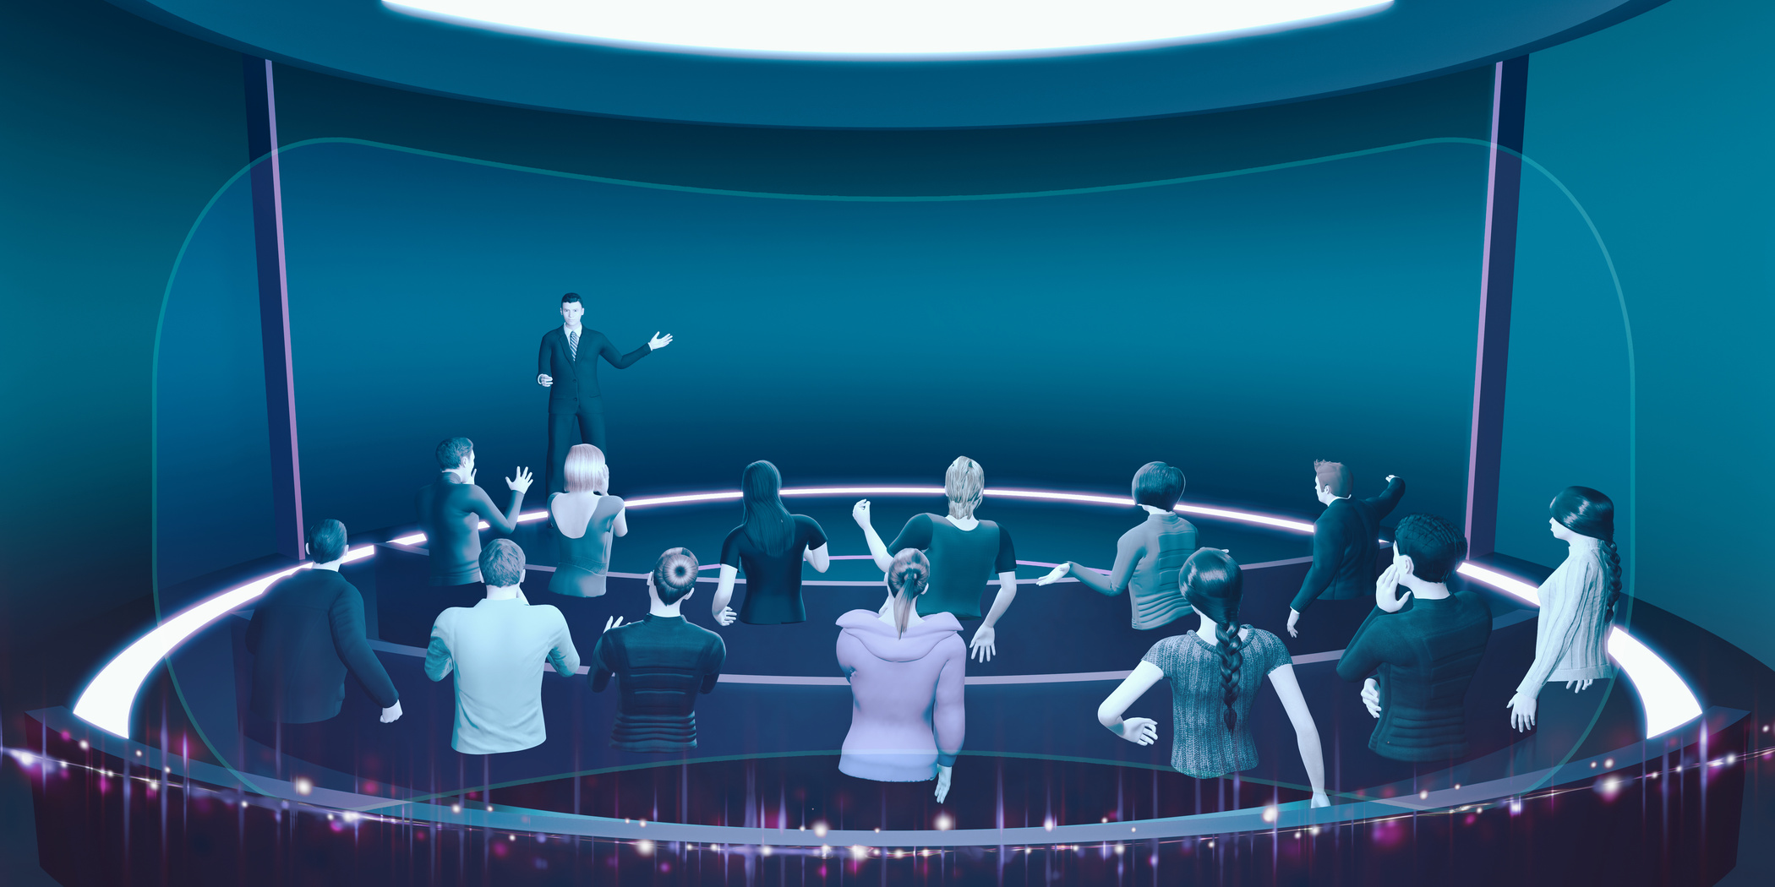
OBJECTIVE
To establish a low-cost digital lab in the metaverse, offering an immersive 3D experience for testing and building projects without risking damage to expensive real-world equipment. The lab aims to revolutionize traditional testing methods, enhance collaboration, and foster innovation through accessible and inclusive virtual simulations.

Slide 7



Slide 8




Designing the Virtual Space
3D Models for Equipment
PROCEDURE
OF EXECUTION
Interactive Features
Collaboration
Integration of Learning Resources
Security Considerations

Slide 9
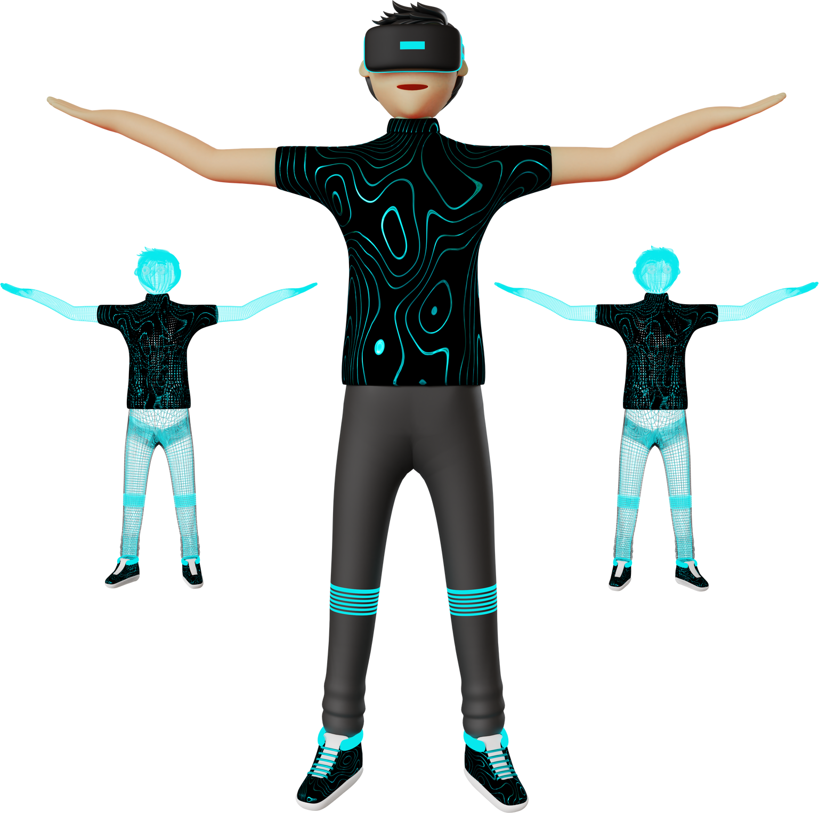
DESIGNING THE VIRTUAL SPACE
Minimalist aesthetics with a combination of high-tech digital displays and tangible 3D models of electronic components.
Each workstation with interactive tools and simulations, fostering collaborative learning and real-time feedback.
Immersive and engaging experience for exploring the world of digital electronics.

Slide 10
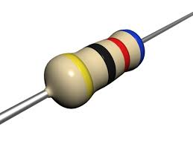
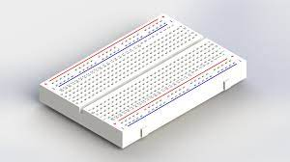
3-D MODEL EQUIPMENT
Here are some essential 3D equipment models typically found in such labs:
RESISTOR
Axial, radial, and surface mount resistors, with various color bands to indicate resistance values.
CAPACITOR
With different polarities, capacitance values, and voltage ratings.
BREAD BOARD
A 3D model of a standard breadboard for prototyping circuits, featuring interconnected rows and columns.

Slide 11
INTERACTIVE FEATURE
A Implement interactive features through scripting or built-in tools to allow users to pick up, move, and connect components to build circuits.
Integrate circuit simulation capabilities to enable real-time modifications and observation of circuit behavior.
Provide immediate feedback on circuit performance with visual indicators and interactive displays

Slide 12
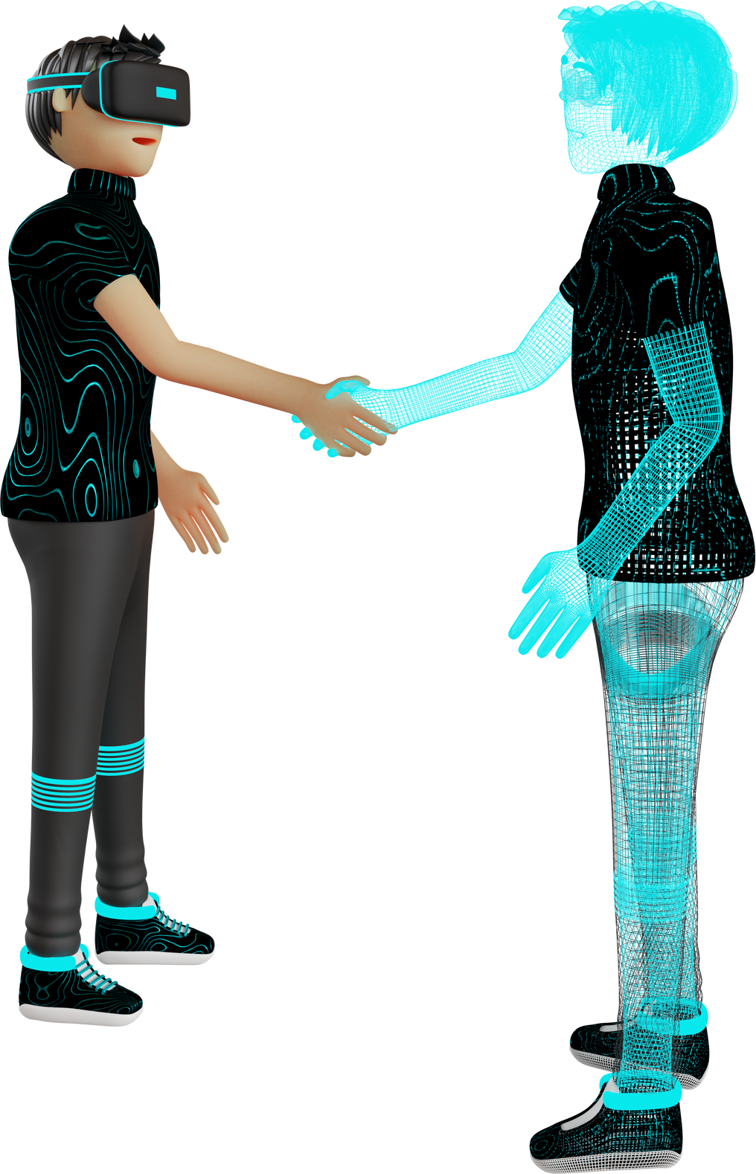
COLLABORATION
Multi-User Support: The platform allows real-time collaboration without significant lag or performance issues.
Shared Circuit Building: Multiple users should be able to pick up and make connections and see each other's actions in real-time.
Communication Tools: Allowing users to communicate with each other while working on circuits.

Slide 13
INTEGRATION OF LEARNING RESOURCES
Digital Resource Repository: Create a central repository within the metaverse lab to store learning materials such as digital textbooks, guides, circuit diagrams, and reference documents.
Interactive Displays: allows learners to refer to materials while building circuits and experimenting.
User Annotations: Enable users to add personal annotations or notes to the learning resources they find helpful

Slide 14

Secure Socket Layer (SSL) Certificates: SSL certificates ensure encrypted communication between users and the metaverse platform
Virtual Private Network (VPN): A VPN application can secure data transmission by creating encrypted connections between users and the lab
Security Information and Event Management (SIEM) Tools: SIEM applications monitor and analyze log data
Security Consideration

Slide 15
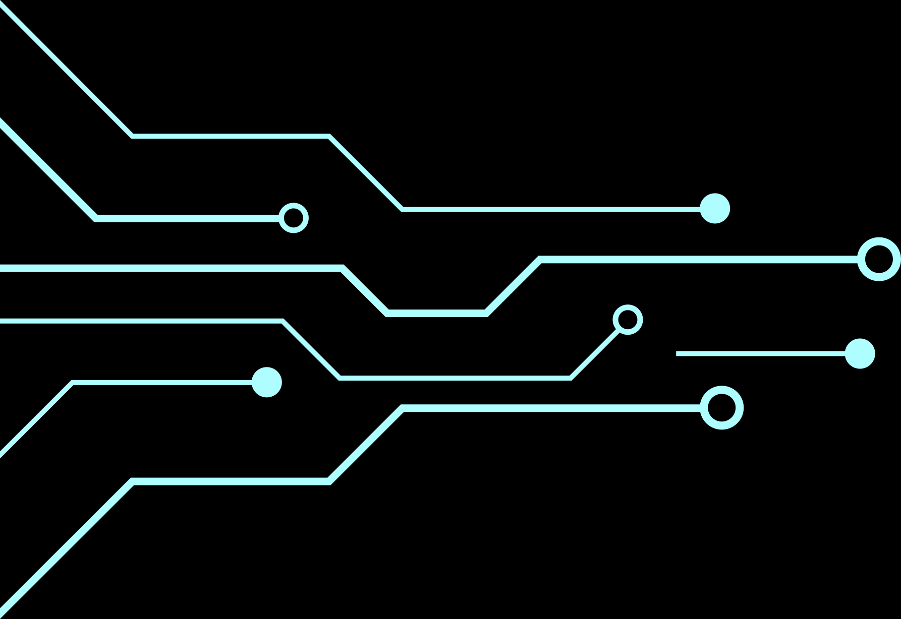

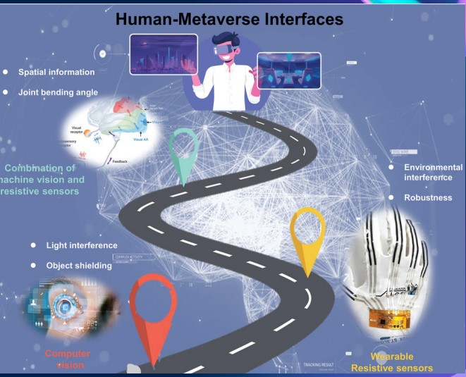
FUTURE SCOPE
Potential improvements to the virtual lab.
Integration with emerging technologies.
Scaling up for larger audiences

Slide 16
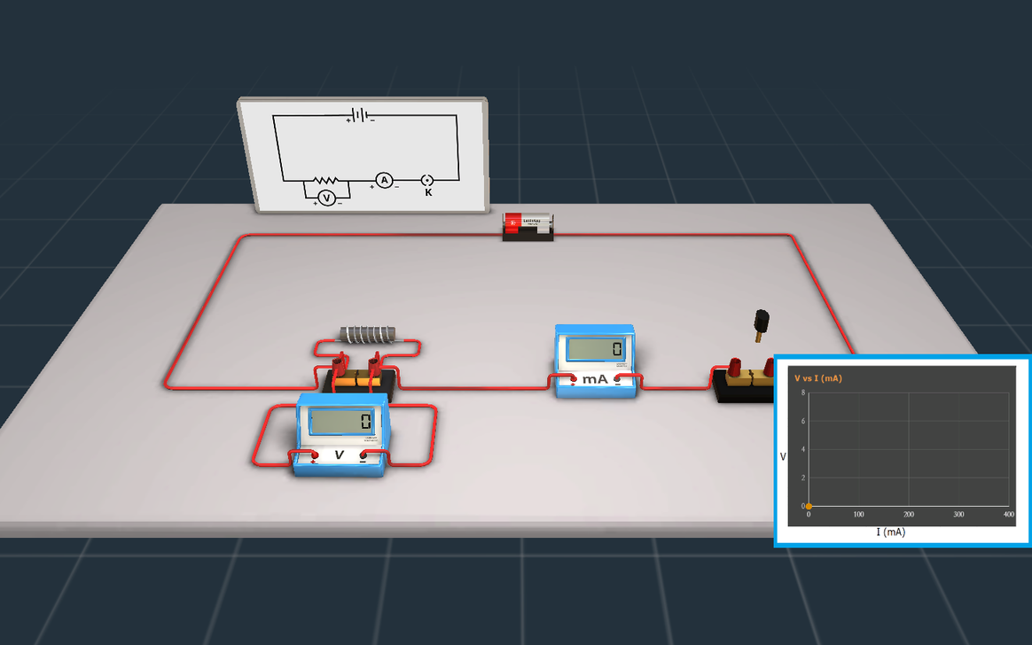
OHM'S LAW VERIFICATION
Our first step towards digital circuit lab in metaverse will be to perform the verification
of ohm's law.
The code file is attached in:
https://github.com/Himanshiprajapati/MetaCircuit-Innovation

Slide 17

"The Metaverse is the ultimate virtual playground:
A place to explore, learn and discover our own identity."

Slide 18
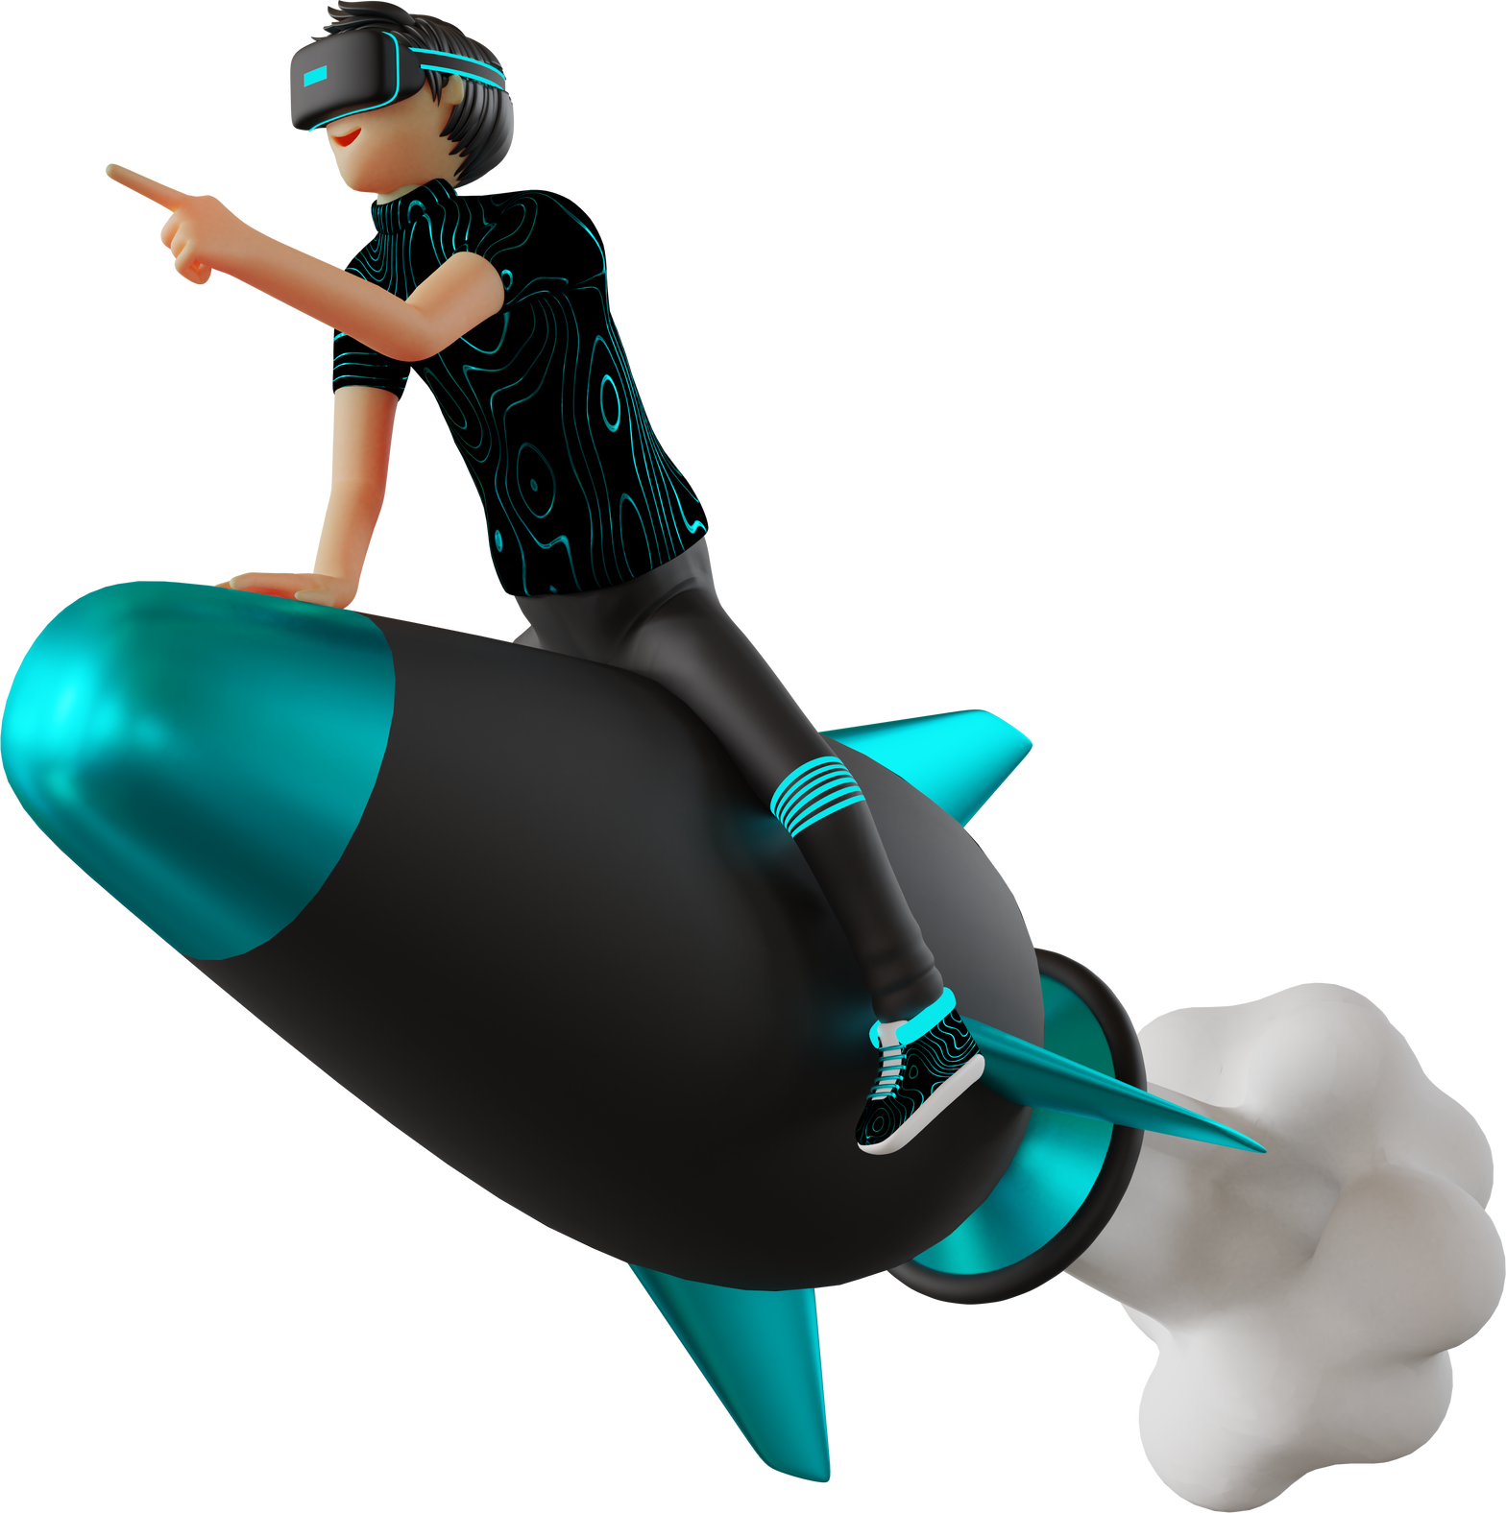

GET IN TOUCH
WITH US
E- MAIL
phimanshi379@gmail.com
pjha285001@gmail.com
prachiyadav11102002@gmail.com

Slide 19
THANK YOU

